Slide 1

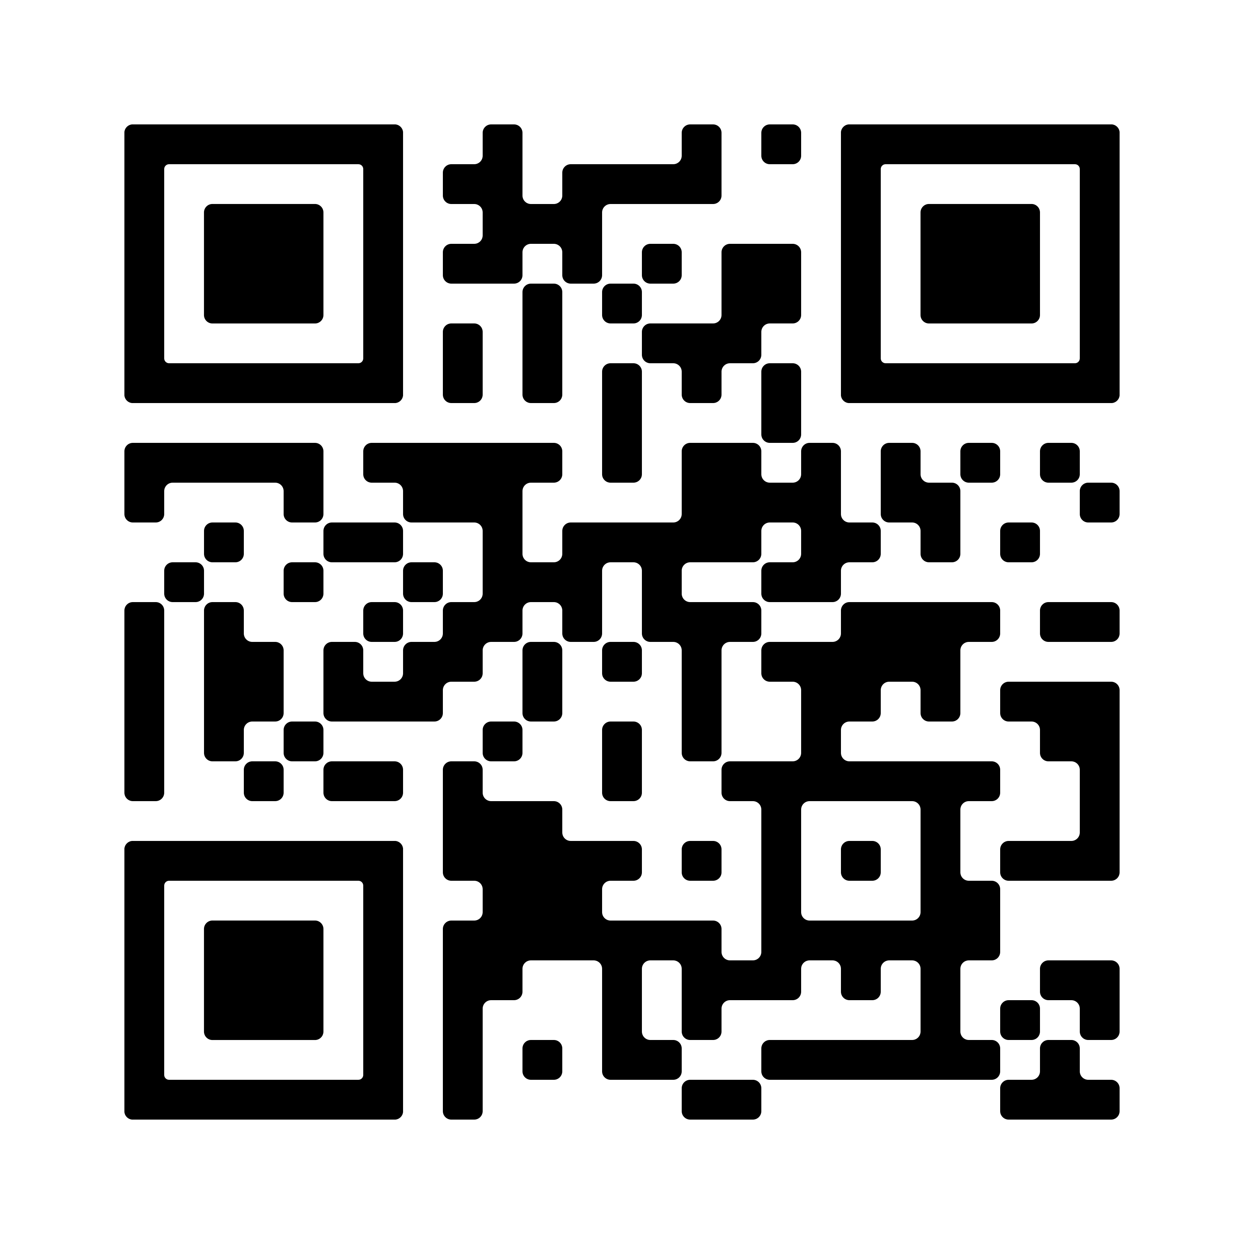
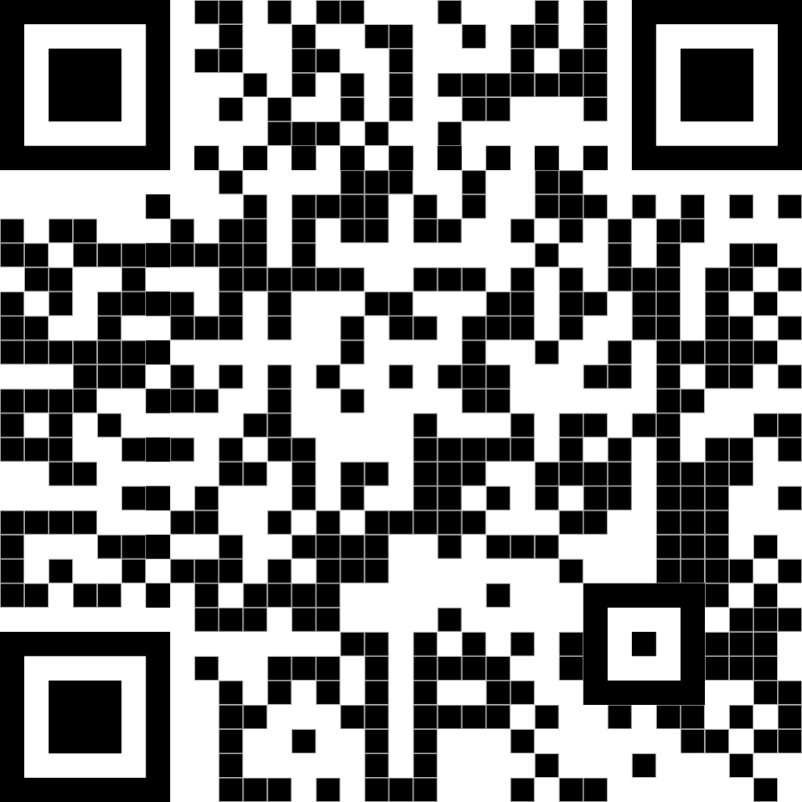
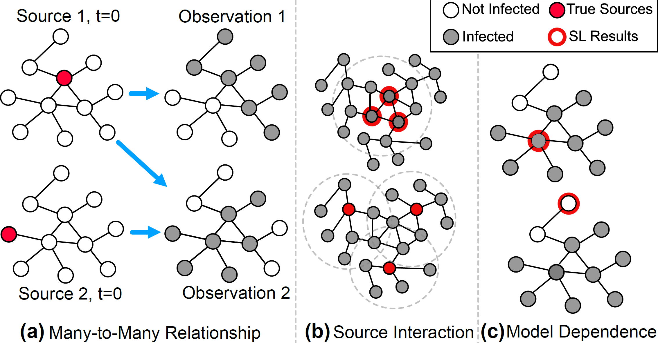
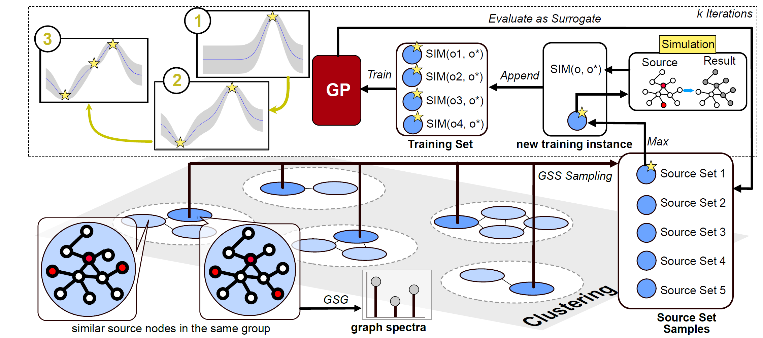
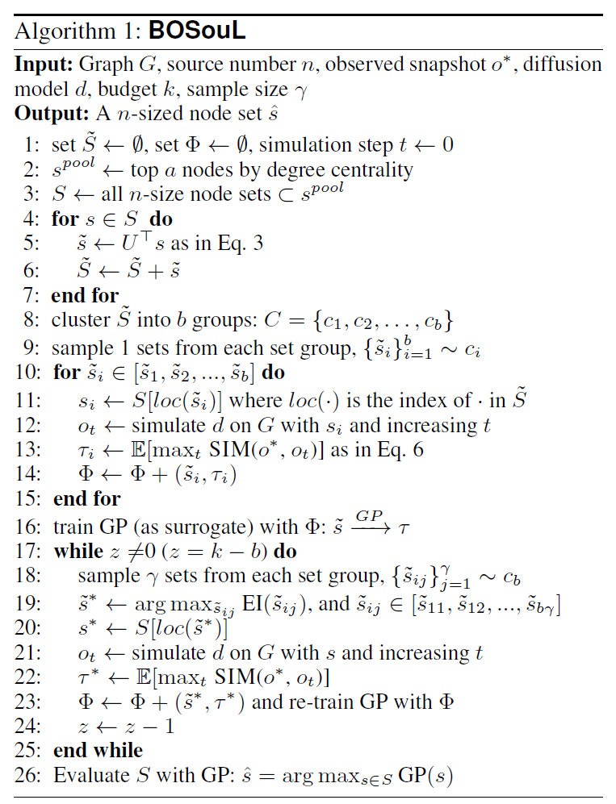
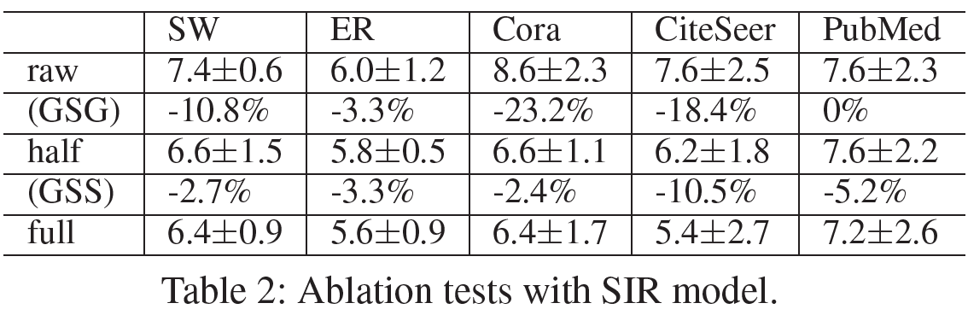
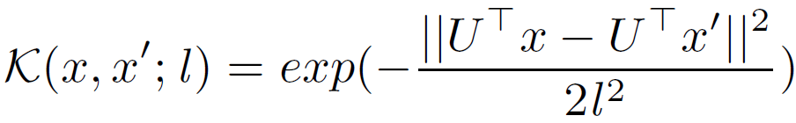
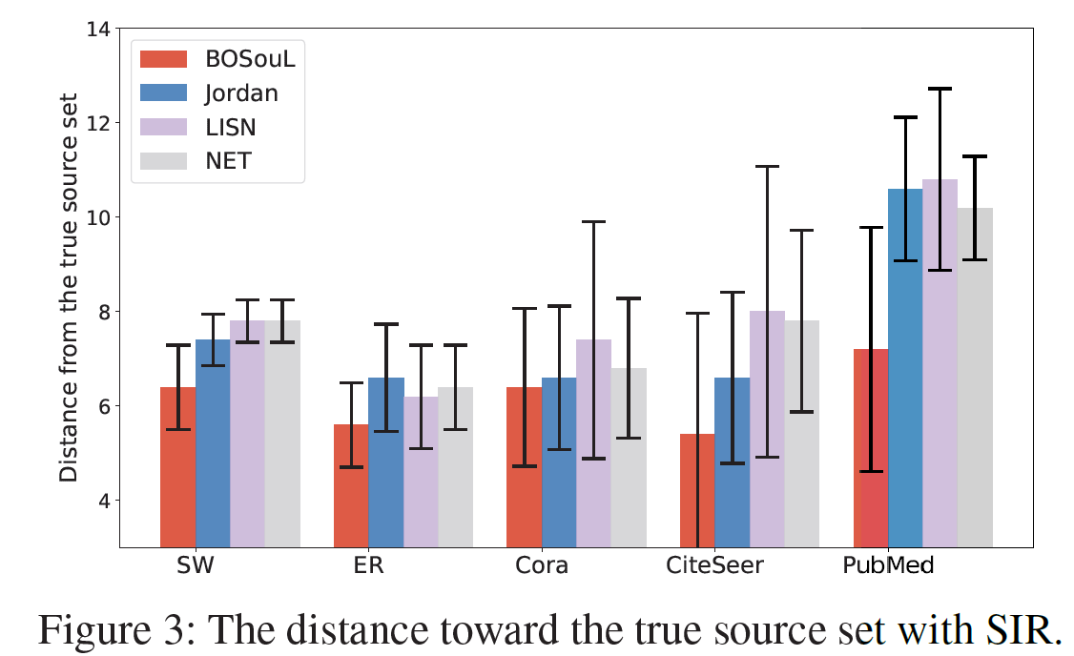
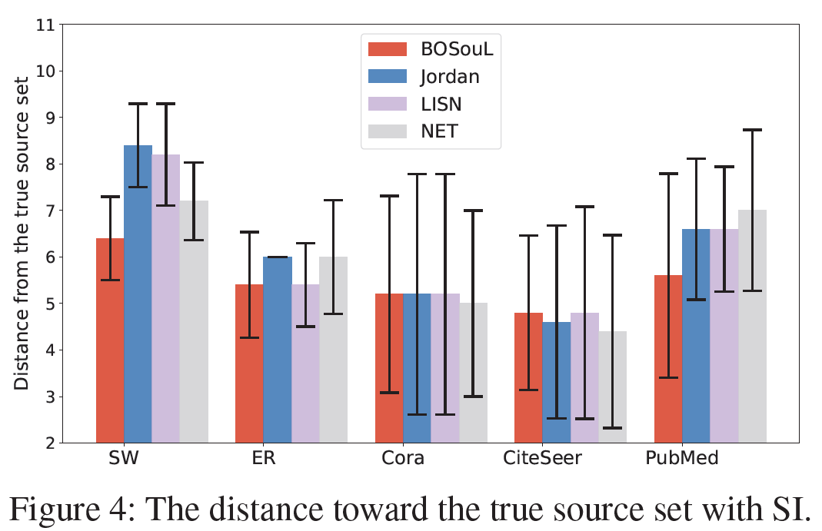
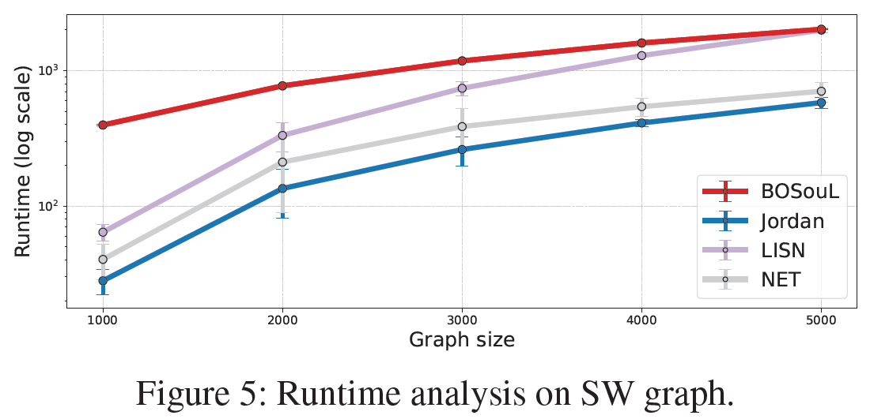
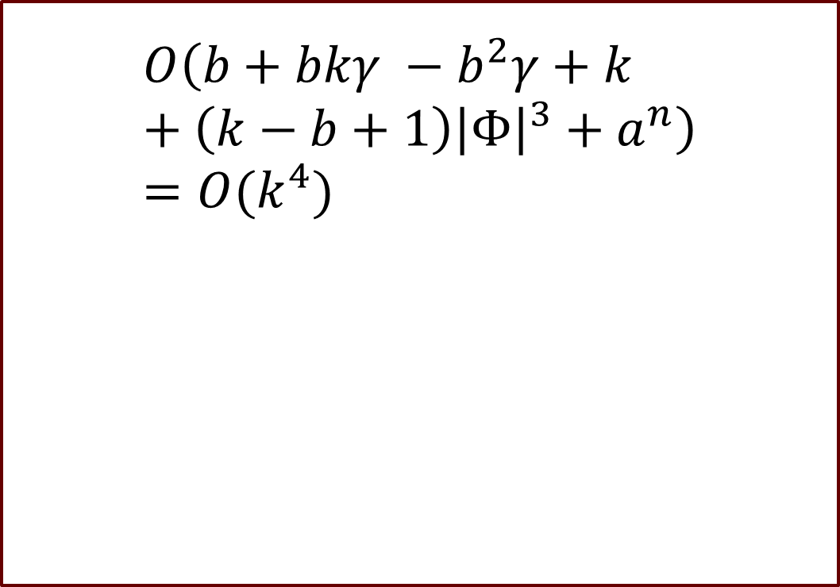
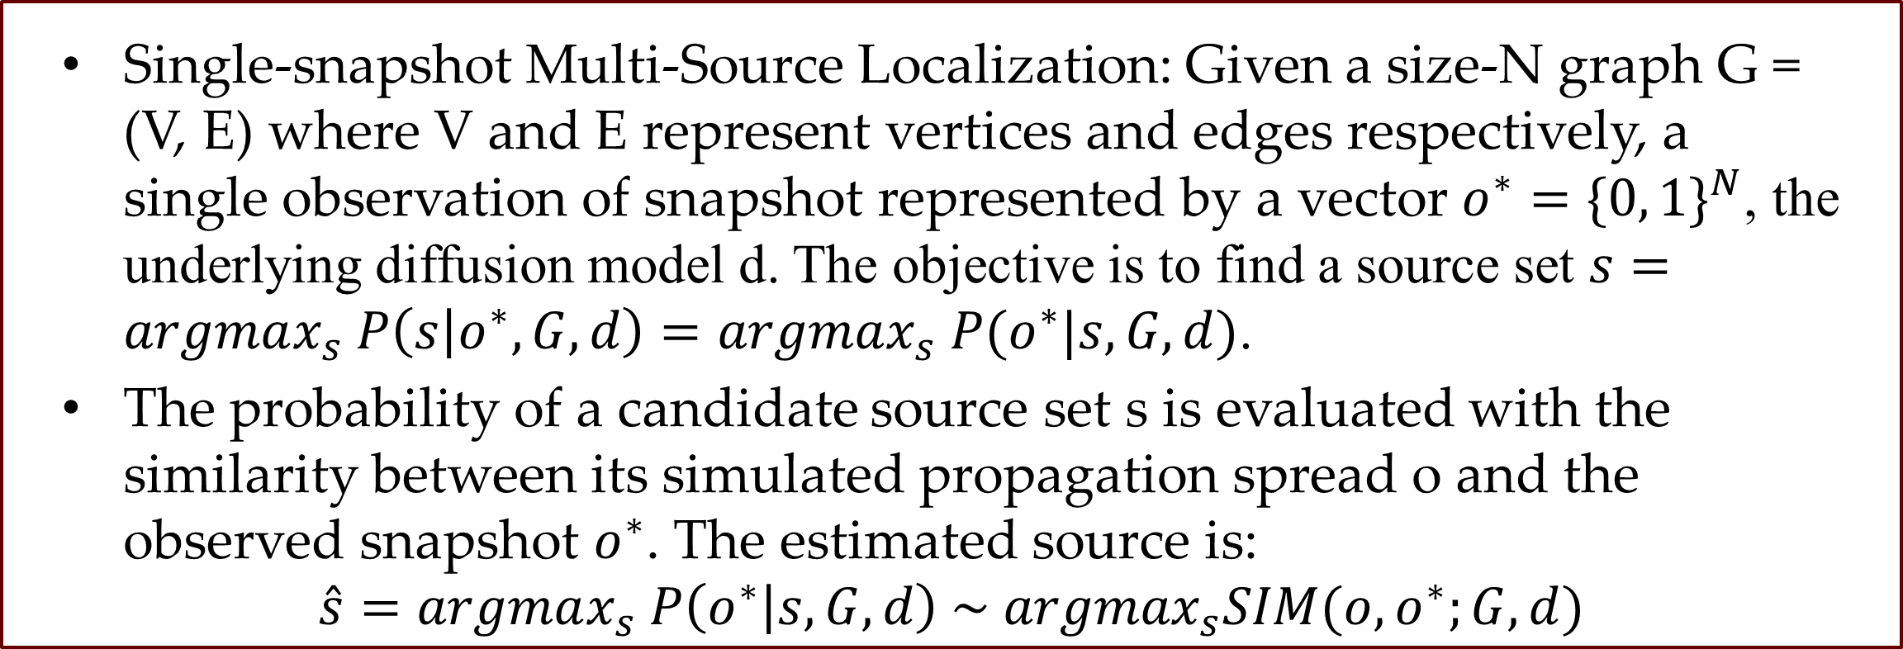
Multiple-Source Localization from a Single-Snapshot Observation Using Graph Bayesian Optimization
AAAI 2024
Code Here ↑
My Website ↑
Zonghan Zhang, Zijian, Zhang, Zhiqian Chen
Computer Science and Engineering, Mississippi State University
Funded by the NSF IIS award # 2153369
Motivation
Source localization: to identify a seed set with the highest possibility given the diffusion spread observation, including complete, monitor, and snapshot observations. Among them, single-snapshot observation is the most common scenario.
Two traditional streams of methods:
Simulation-based methods: too slow, infeasible due to the combinatorial nature and the #P-hardness of evaluating each set.
Heuristic methods: dominating the multi-source localization problem.
Challenges the current heuristic methods cannot adequately address:
Many-to-many relationship between sources and spreads.
Complicated interactions among the sources.
Heavy dependence on diffusion models.
Main Contribution
Problem Setup
We propose an efficient simulation-based method utilizing Bayesian optimization named BOSouL.
The multiple sources are evaluated as a set instead of individually.
Our method can be combined with any diffusion model.
We provide time complexity analysis. Extensive empirical experiments are conducted.
Single-snapshot Multi-Source Localization: Given a size-N graph G = (V, E) where V and E represent vertices and edges respectively, a single observation of snapshot represented by a vector $o^{∗}={\{0, 1\}}^{N}$, the underlying diffusion model d. The objective is to find a source set $s=argmax_{s} P\left(s | o^{∗}, G, d\right)=argmax_{s} P(o^{∗}|s, G, d)$.
The probability of a candidate source set s is evaluated with the similarity between its simulated propagation spread o and the observed snapshot $o^{∗}$. The estimated source is:
$$\hat{s}=argmax_{s} P\left(o^{∗} | s, G, d\right) \sim argmax_{s}SIM(o, o^{∗};G, d)$$
The Proposed Method: BOSouL
Graph Spectral Gaussian (GSG) Kernel
Graph Stratified Sampling (GSS)
Apply Fourier Transformation to the source vector s.
Combine the Fourier signal with RBF kernel
GSG is a valid Mercer Kernel for GP.
Traditional sampling methods do not fit the source localization problem due to the discrete property of the graph data.
GSS clusters over graph Fourier signals, and samples equal-size candidates from each cluster.
GSS explore the searching space better than random sampling and has lower variance.
Time Complexity
Empirical Experiments
$$O\left(b+bkγ −b^{2}γ+k+\left(k−b+1\right){\left|Φ\right|}^{3}+a^{n}\right) \\ =O(k^{4})$$

